Slide 1
2019
2019
Face Recognition with KNN in MATLAB
Report：YangBingxue

Slide 2
CONTENTS
Follow chart
PCA/KNN
Result

Slide 3
Follow chart

Slide 4
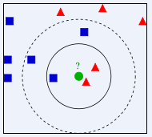
PCA/KNN

Slide 5
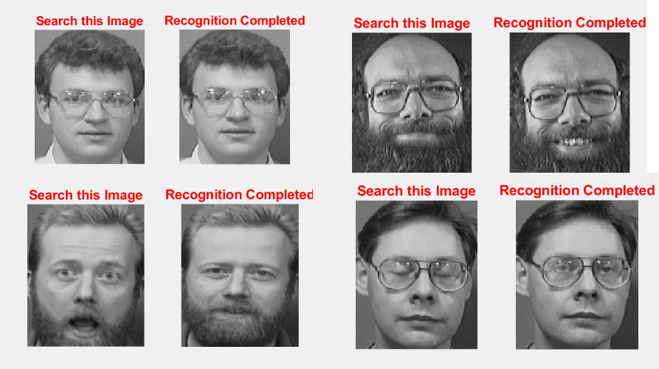
Result

Slide 6
THANKS
Report：YangBingxue

